Slide 1

CMR Institute Of Technology
Department of Computer Science and Engineering
Major Project Review - 3
Travel Plan Itinerary Generator
Guide:
Mrs. S. Jenifer
Assistant Professor Dept. of CSE CMRIT
Presented By:
22R01A0529 - Hruday Kumar Kotha
22R01A0532 - Mithun Reddy Maddula
22R01A0536 - Uday Manda
22R01A0569 - Vivekananda Bhoomipaka

Slide 2
Abstract
The Travel Plan Itinerary Generator is an intelligent application designed to simplify and personalize the process of travel planning. By leveraging user preferences, destination data, and real-time information such as weather and local events, the system automatically generates optimized daily itineraries tailored to individual interests and constraints. The platform integrates machine learning algorithms and heuristic optimization techniques to balance factors like travel time, activity duration, and user priorities, ensuring a seamless and enjoyable travel experience. This approach reduces the time and effort typically required for itinerary creation while enhancing trip satisfaction through data-driven recommendations. The Travel Plan Itinerary Generator aims to empower travelers with smart, adaptive planning tools that cater to diverse needs and evolving travel trends.

Slide 3
Introduction
Planning a trip can often be a complex and time-consuming task, involving multiple decisions such as selecting destinations, arranging accommodations, scheduling activities, and managing transportation. Travelers frequently face challenges in organizing these components efficiently while balancing personal preferences, budget constraints, and time limitations. With the rapid advancement of technology, especially in artificial intelligence and data analytics, there is a growing opportunity to automate and personalize the travel planning process.
The Travel Plan Itinerary Generator is designed to address these challenges by providing users with an intelligent, automated tool that generates optimized travel itineraries tailored to their interests, travel dates, and budget.

Slide 4
Literature survey
• Automated Itinerary Planning Systems Early research in travel itinerary generation focused on rule-based and heuristic systems that automatically create travel plans based on user preferences, time constraints, and popular tourist destinations. These systems used static databases of attractions and fixed scheduling rules to produce feasible daily plans.
• Personalization through User Preferences and Constraints Recent approaches incorporate personalization by leveraging user profiles, travel interests, budget limits, and mobility constraints to tailor itineraries. Machine learning models and recommendation algorithms analyze past user behavior or similar travelers’ data to enhance relevance and satisfaction.

Slide 5
Existing System
Most existing travel itinerary generators rely heavily on static templates and rule-based approaches, often requiring users to manually input preferences and adjust plans. These systems typically aggregate data from a limited set of sources such as popular travel websites, predefined attractions, and fixed time slots, which restricts their flexibility and personalization capabilities. While some platforms provide basic customization options, they generally fail to adapt dynamically to user behavior, real-time conditions like weather or local events, and evolving travel trends. Furthermore, many current solutions lack integration with AI technologies, limiting their ability to recommend optimal routes, suggest hidden gems, or provide efficient time management, resulting in suboptimal travel experiences.

Slide 6
Drawbacks
• Limited Personalization Most existing itinerary generators rely on static templates or generic recommendations that do not adapt well to individual preferences, travel styles, or budgets.
• Lack of Real-Time Updates Many systems do not provide real-time information such as changes in weather, flight delays, or local event schedules, which can make itineraries less reliable.

Slide 7
Proposed System
The proposed Travel Plan Itinerary Generator leverages artificial intelligence and machine learning to create personalized, adaptive, and context-aware itineraries. By analyzing user preferences, travel history, and real-time data such as weather forecasts, traffic conditions, and local event schedules, the system dynamically optimizes daily plans to maximize user satisfaction. It integrates multiple data sources, including reviews, social media trends, and transportation options, to recommend not only popular destinations but also off-the-beaten-path experiences tailored to individual interests. Additionally, the system features natural language processing for intuitive user interaction and continuous learning capabilities to refine recommendations over time. This results in a highly customizable, efficient, and enjoyable travel planning tool that significantly outperforms traditional itinerary generators.

Slide 8
Advantages
• Personalized Itinerary Generation Utilizing AI and machine learning, the proposed system customizes travel plans based on user preferences, interests, budget, and past travel behavior for highly tailored experiences.
• Real-Time Data Integration Incorporates live updates on weather, flight statuses, traffic conditions, and local events to dynamically adjust the itinerary and minimize disruptions.

Slide 9
HARDWARE REQUIREMENTS:
System : i3
Hard Disk : 250 GB
RAM : 4 GB
SOFTWARE REQUIREMENTS:
Operating system : Windows Family
Coding Language : Python

Slide 10
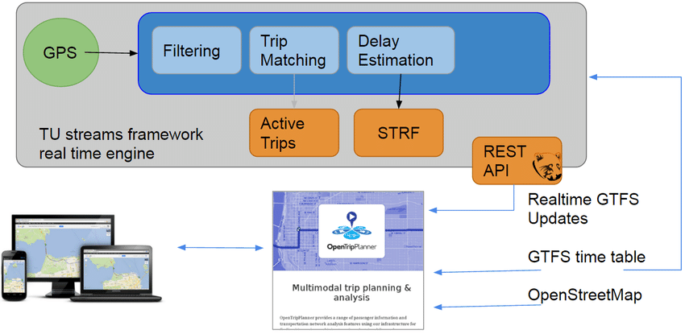
System Architecture:

Slide 11
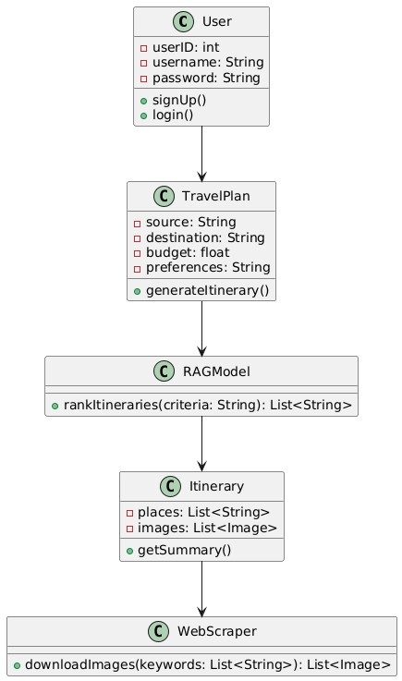
Class Diagram
The Class Diagram defines the system’s structure. Key classes include User (handles authentication), TravelPlan (stores trip details), RAGModel (ranks itineraries), Itinerary (stores the final travel plan), and WebScraper (downloads images). Attributes and methods for each class define their roles and interactions.

Slide 12
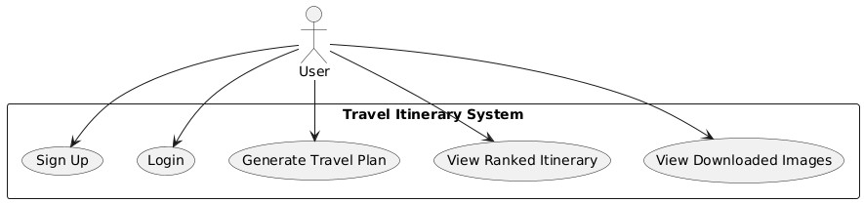
USE CASE DIAGRAM
Main Use Cases:
Register Account
Login
Enter Travel Preferences
Generate Itinerary
View Recommended Hotels
View Nearby Attractions
View Weather Information
Download Itinerary (PDF/Word)
Save Itinerary
Update/Delete Itinerary
Admin manages destinations, data sources
The Use Case Diagram shows how users and the system interact. Main actions include registering, logging in, entering travel preferences, generating itineraries, viewing hotels and attractions, saving or downloading plans, and admin management of destinations and data sources. It provides a high-level view of system functionality from the user’s perspective.

Slide 13
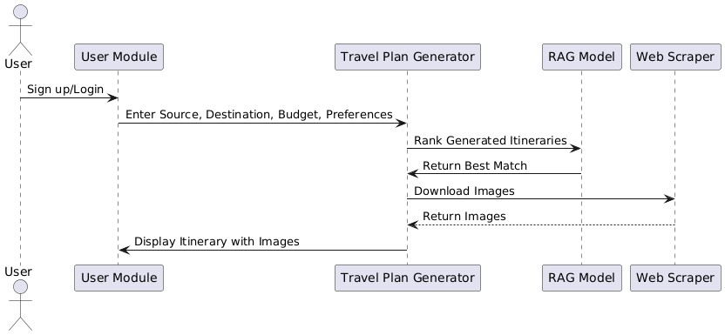
Sequence Diagram:
The Sequence Diagram shows the interaction between objects over time. Users log in, create a travel plan, generate itineraries through the RAGModel, fetch images using the WebScraper, and receive the final itinerary with recommendations. It clarifies the order of operations in the system.

Slide 14
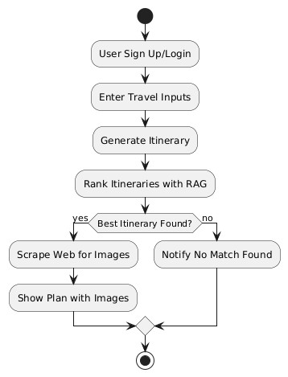
Activity Diagram
The Activity Diagram represents the step-by-step workflow of itinerary generation. Users provide destination, dates, budget, and preferences. The system validates input, collects travel data, and uses an AI model to create and optimize the itinerary. Finally, the itinerary is displayed for the user to save or download.

Slide 15
Modules
1. User Interface Module
2. User Profile and Preferences Module
3. Destination and Activity Recommendation Engine
4. Itinerary Planner and Scheduler Module
5. Transport and Accommodation Integration Module
6. Budget Estimation and Expense Tracker Module
7. Weather and Travel Advisory Module
8. Feedback and Review Module

Slide 16
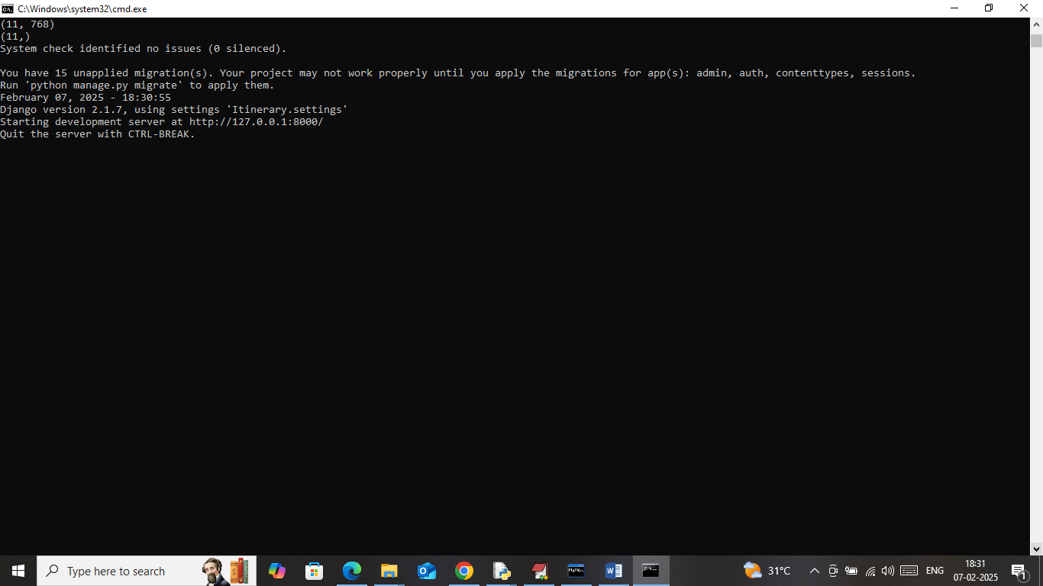

Slide 17
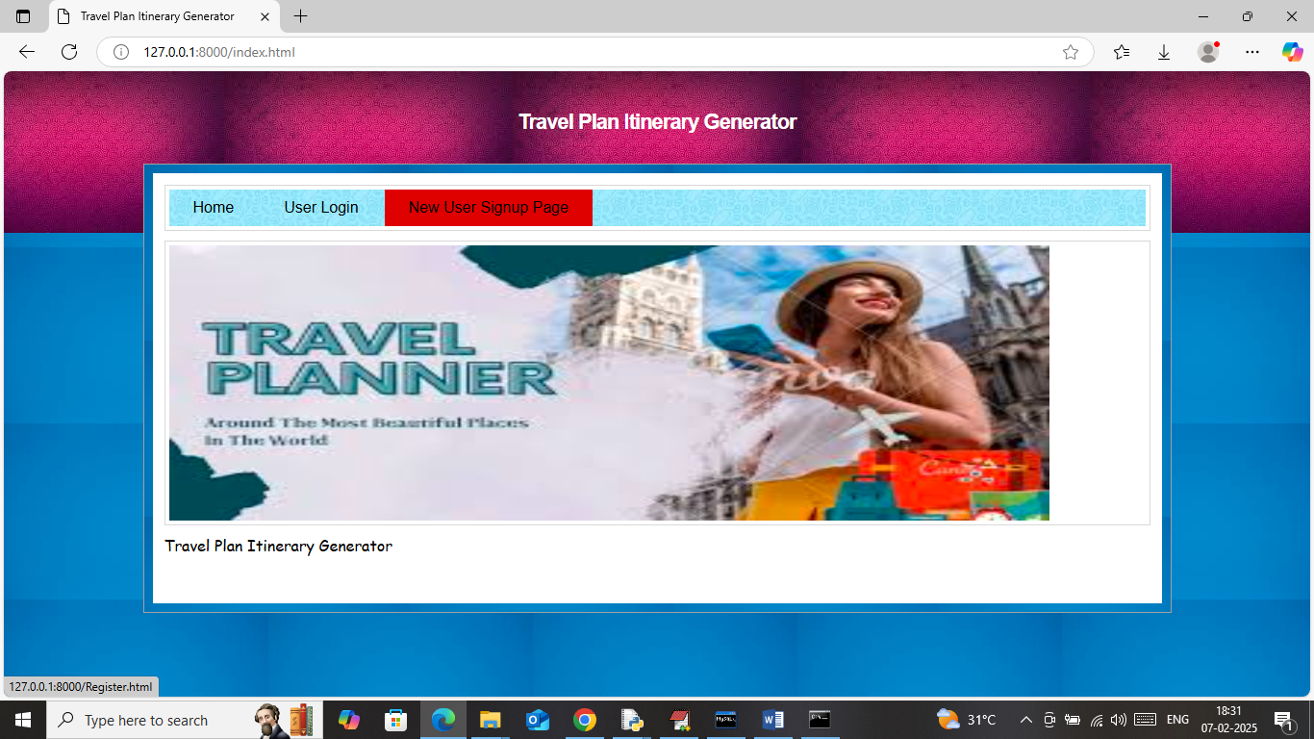

Slide 18
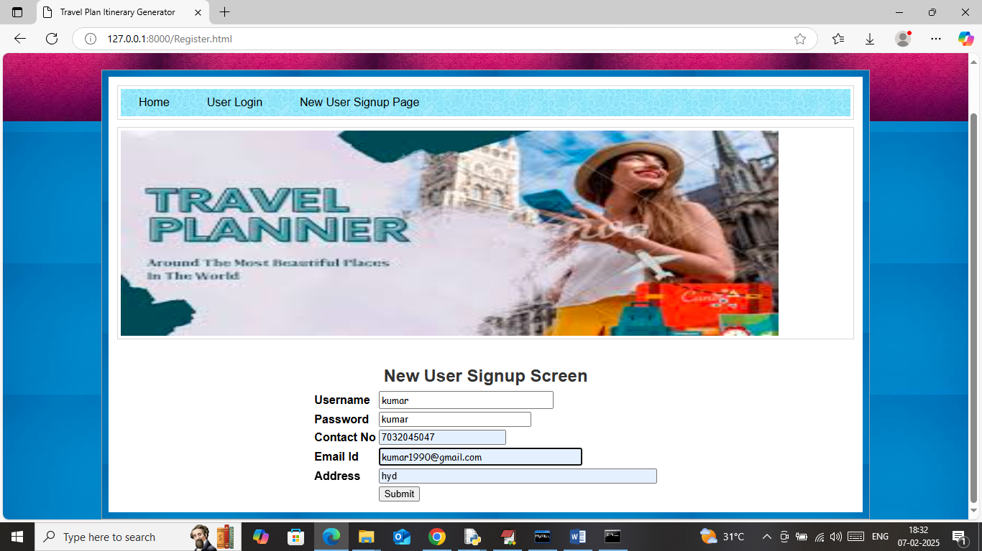

Slide 19
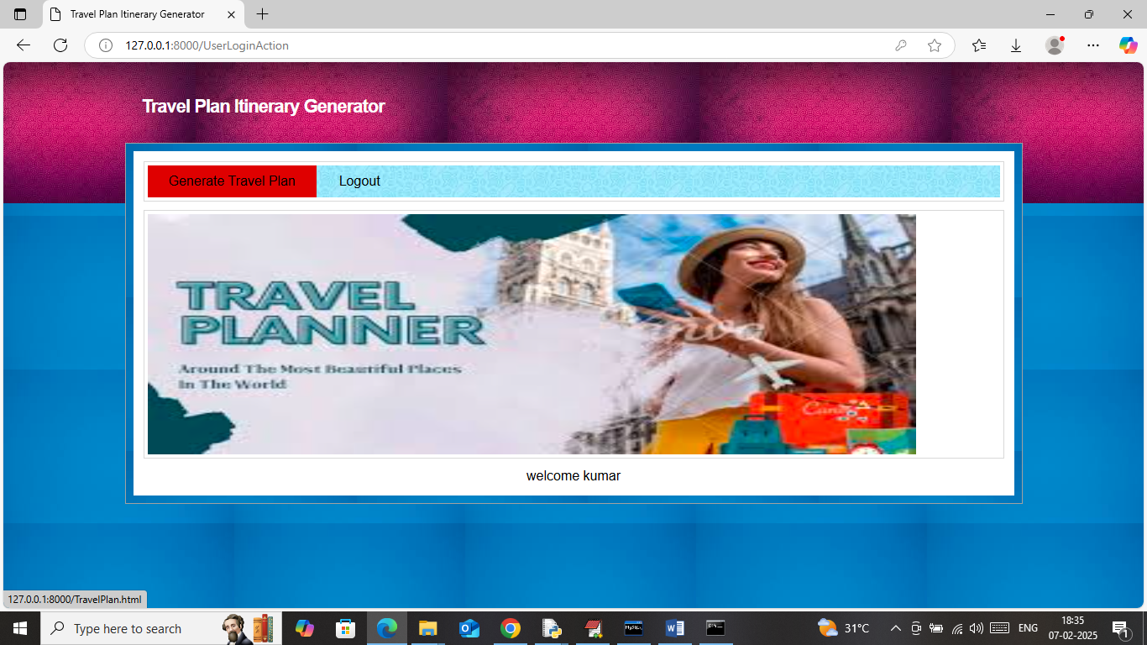

Slide 20
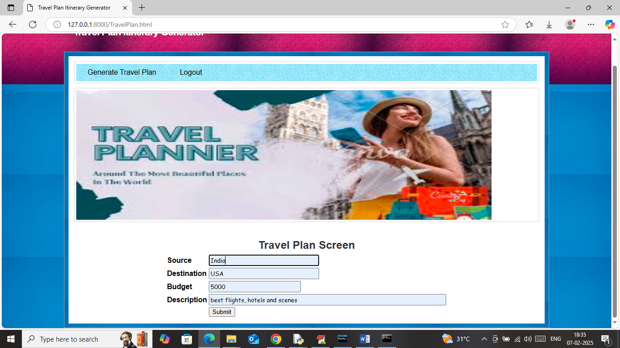

Slide 21
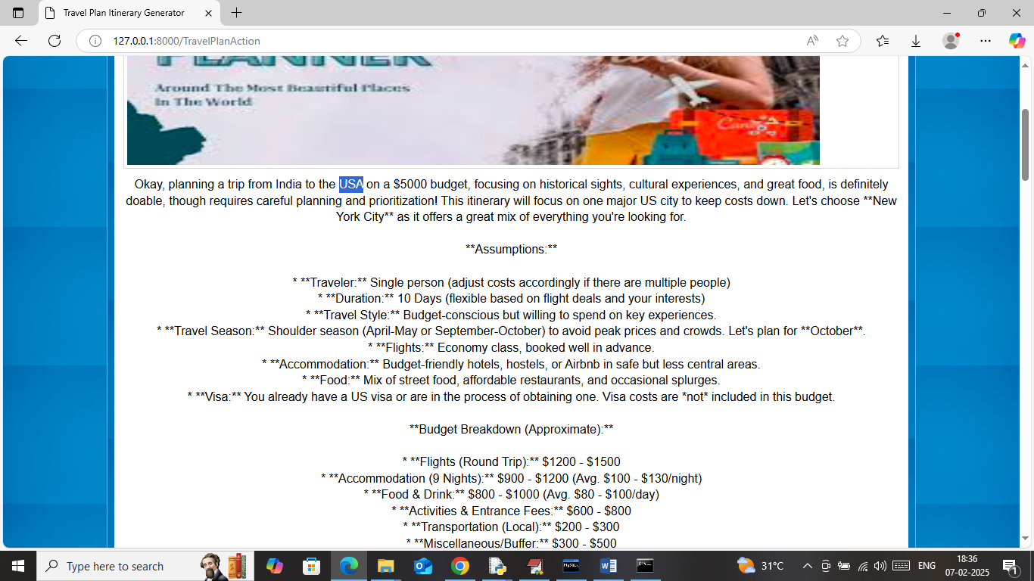

Slide 22
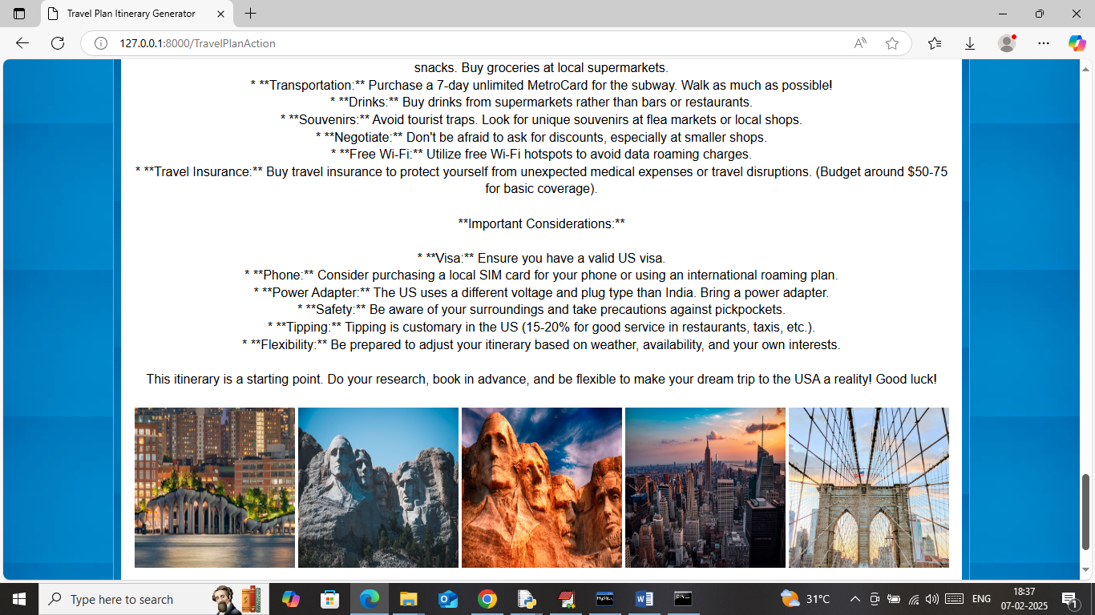

Slide 23
Conclusion
The Travel Plan Itinerary Generator offers an intelligent and user-centric approach to planning personalized travel experiences. By integrating user preferences, real-time data, and optimization algorithms, the system automates itinerary creation to deliver efficient, enjoyable, and customizable travel plans. The platform enhances the travel experience by considering factors such as location proximity, opening hours, budget, travel time, and user interests. This not only simplifies the traditionally time-consuming process of trip planning but also makes travel more accessible and tailored to individual needs. The adoption of such technology demonstrates the power of AI and data-driven solutions in the tourism and hospitality sectors, offering practical benefits for both casual tourists and travel professionals.

Slide 24
Future work
Future enhancements of the itinerary generator could include deeper integration of AI, such as natural language processing to understand user intent more accurately, and machine learning to recommend destinations based on user history and behavior. Incorporating real-time updates like weather forecasts, local events, and transport delays can make itineraries more adaptive and reliable. Another area of development involves integrating social media sentiment analysis to refine recommendations based on recent traveler reviews. Enhancing multi-user itinerary collaboration will be useful for group travel planning. Finally, implementing augmented reality features for on-the-go exploration and combining blockchain for secure travel transactions and identity verification could make the platform a more robust, trustworthy solution in the smart tourism ecosystem.

Slide 25
Reference
Borràs, J., Moreno, A., & Valls, A. (2014). Intelligent tourism recommender systems: A survey. Expert Systems with Applications, 41(16), 7370–7389.
Gavalas, D., Konstantopoulos, C., Mastakas, K., & Pantziou, G. (2014). Web application for personalized trip planning. Expert Systems with Applications, 41(16), 7231–7240.
Xu, Z., et al. (2020). TripRec: A novel framework for personalized trip recommendation. ACM Transactions on Intelligent Systems and Technology, 11(3), 1–24.
Aliannejadi, M., et al. (2019). Personalized itinerary recommendation for tourists based on user reviews. Information Processing & Management, 56(6), 102091.

Slide 26
THANK YOU

